Slide 1
SCHOOL APPRENTICESHIP OFFICERS
Department for Education

Slide 2
Our Role
Promote School Based Apprenticeships/Traineeships
Make the transition from school to work as a School Based Apprentice/Trainee (Sbat) as Informative & smooth as possible for Students, Parents/Carers, Schools & Employers.
Industry Experience
Apprenticeship/Traineeship Knowledge

Slide 3

Pathways to a Career

Slide 4
What is an Apprenticeship
Apprenticeships offer opportunities for you to train, study and earn an income
Usually for a period of 4 years
Develop real skills for real careers
Experience training that is hands-on
Gain a nationally recognised qualification
Earn a wage while you learn

Slide 5
What is a Traineeship
The format is the same as an apprenticeship only for a shorter period.
Usually you can complete a Traineeship in 1 to 3 years.
Usually entry level roles, allowing you to get a foot in the door.

Slide 6
What is a School Based Apprenticeship/Traineeship
Earn credits towards your SACE from your training.
A customised approach to senior school education.
You attend school part of the week, complete hands on training in the workplace and some formal off-job learning at a training provider.
Eliminates the gap between exiting school and entering the workforce.
Notes:
Avoid saturated employment market – Dec-Jan every year with all other school leavers.

Slide 7
Flexible School Based Apprenticeship/Traineeship
SBATs commence in years 10, 11 and can transition into a Flexible SBAT in year 12.
A Flexible SBAT allows students to be in the workplace on a near full-time basis during their final year of school.
Every student will have a tailored SACE completion plan for their own circumstance.

Slide 8
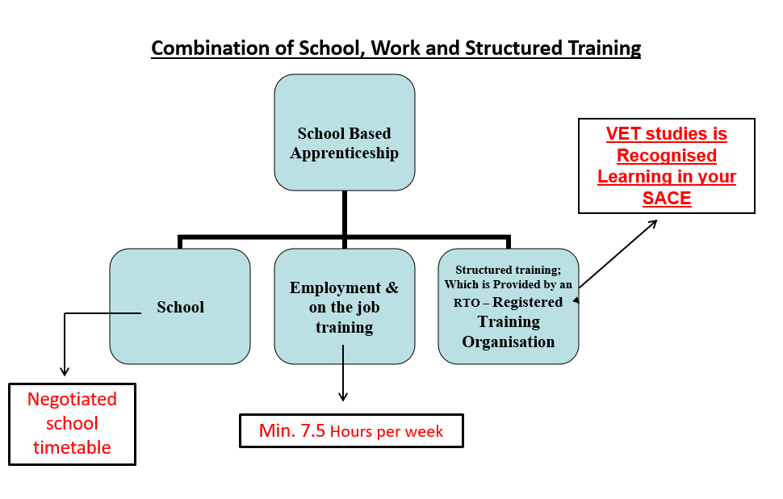

Slide 9
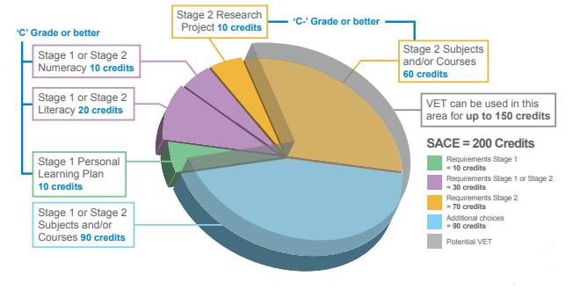
SACE

Slide 10
Where too from here?
Undertake some work experience to find out what type of work you like doing.
Develop a resume that relates to the field of work you are applying for.
Pursue Vocational Education & Training (VET).
Undertake Industry aptitude testing.
Seek a casual job.
Look to obtain a drivers licence ASAP.

Slide 11
Questions?
If you would like to book a time with an Apprenticeship Officer please complete the Student Expression of Interest form

