Slide 1
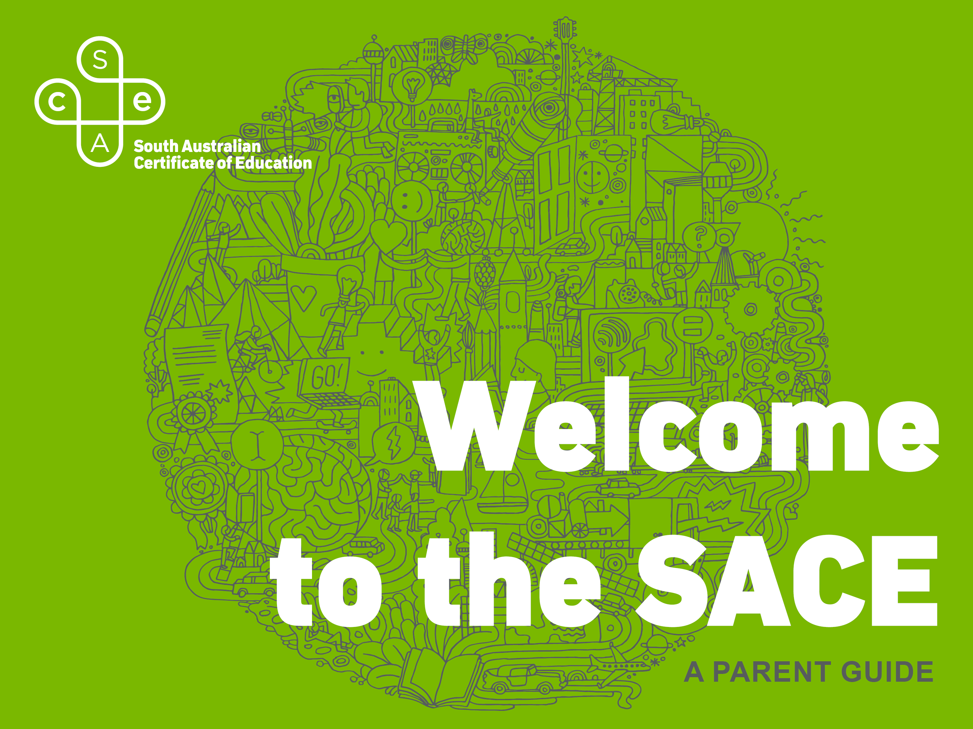

Slide 2

VIDEO: The value of the SACE
Notes:
This VIDEO is a short introduction on the value of the SACE, introduced by SACE Board Chief Executive, Professor Martin Westwell.

Slide 3

INTERNATIONALLY recognised qualification
DESIGNED to develop your child’s capabilities
SKILLS needed to be successful in the 21st century
FLEXIBLE timeframe and choice of subjects
Notes:
An internationally recognised qualification for life designed to help develop your child’s capabilities.
Designed to develop their skills and knowledge to live, work and participate successfully in an ever changing society.
Offer your child the flexibility to choose their subjects and complete the qualification in a timeframe that suits them and their lifestyle.

Slide 4
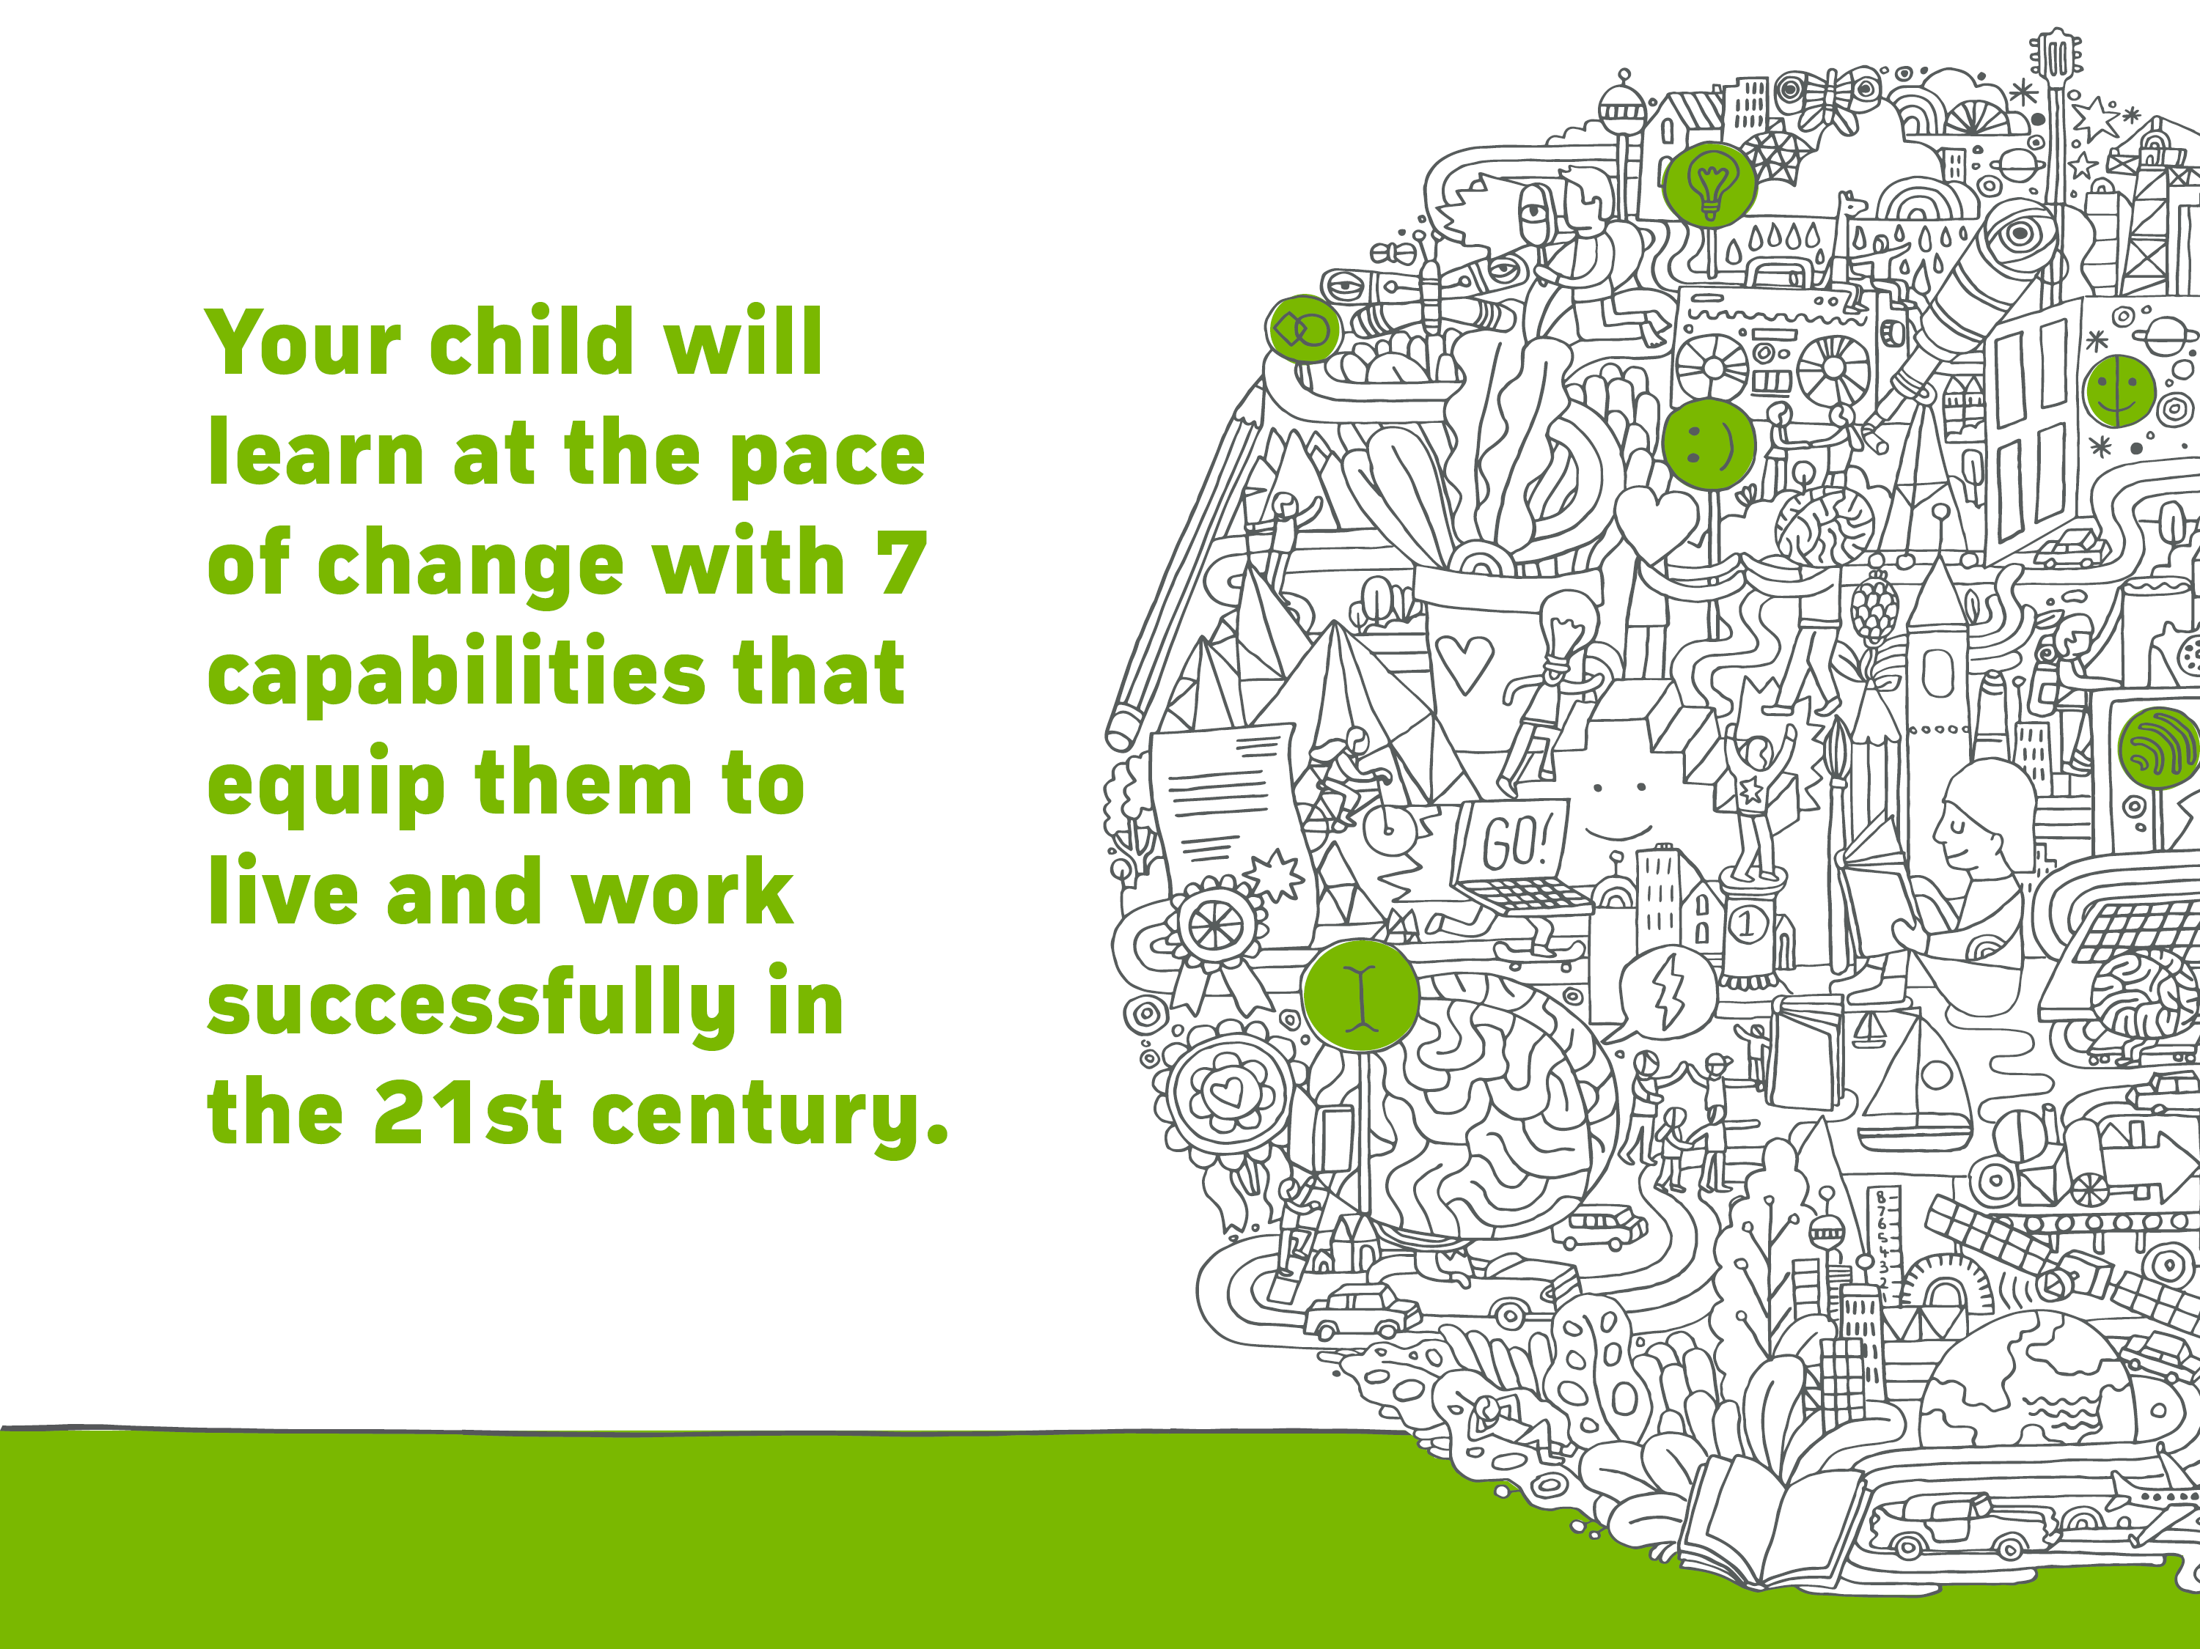
Notes:
Capabilities -
As your child studies the SACE, they gain valuable literacy, numeracy, critical thinking and problem-solving skills, while gaining knowledge about the specific subjects they choose.
The SACE also helps them learn how to work with and alongside others, and to understand how their decisions can affect people, situations and the world.
These capabilities are essential to their future education, training and careers, and their role as an active and informed citizen.
The SACE brand illustration depicts the world of change within which students learn, and the capabilities they achieve along the way.

Slide 5








Notes:
We want our students to explore their capabilities, challenge themselves and discover what they can achieve.
Literacy - We develop skills to understand and interpret a variety of texts and people in a range of different situations and countries.
Critical and creative thinking - We use critical and creative thinking skills to identify and analyse complex topics and questions, and develop innovative solutions.
Ethical understanding - We develop a deep understanding of ethical issues and how to manage them.
Intercultural understanding - We appreciate and respect other people’s social and cultural backgrounds and learn about the diversity of our nation and the world.
Personal and social - We are confident, self-disciplined and independent people, who can work in a team and are resilient to deal with challenging situations.
Information and communication technology - We learn how to use current and emerging technologies and understand their impact on society and the workplace.
Numeracy - We gain knowledge to use Mathematics to effectively interpret information and make recommendations.

Slide 6

Notes:
Tonight we will be looking at your child’s SACE journey, how they will become a successful and resilient learner, a confident and creative individual and an active and informed citizen who at the end of their journey will be ready to succeed in further education, training or the workforce.
To start we will take a quick look at how the SACE works.

Slide 7
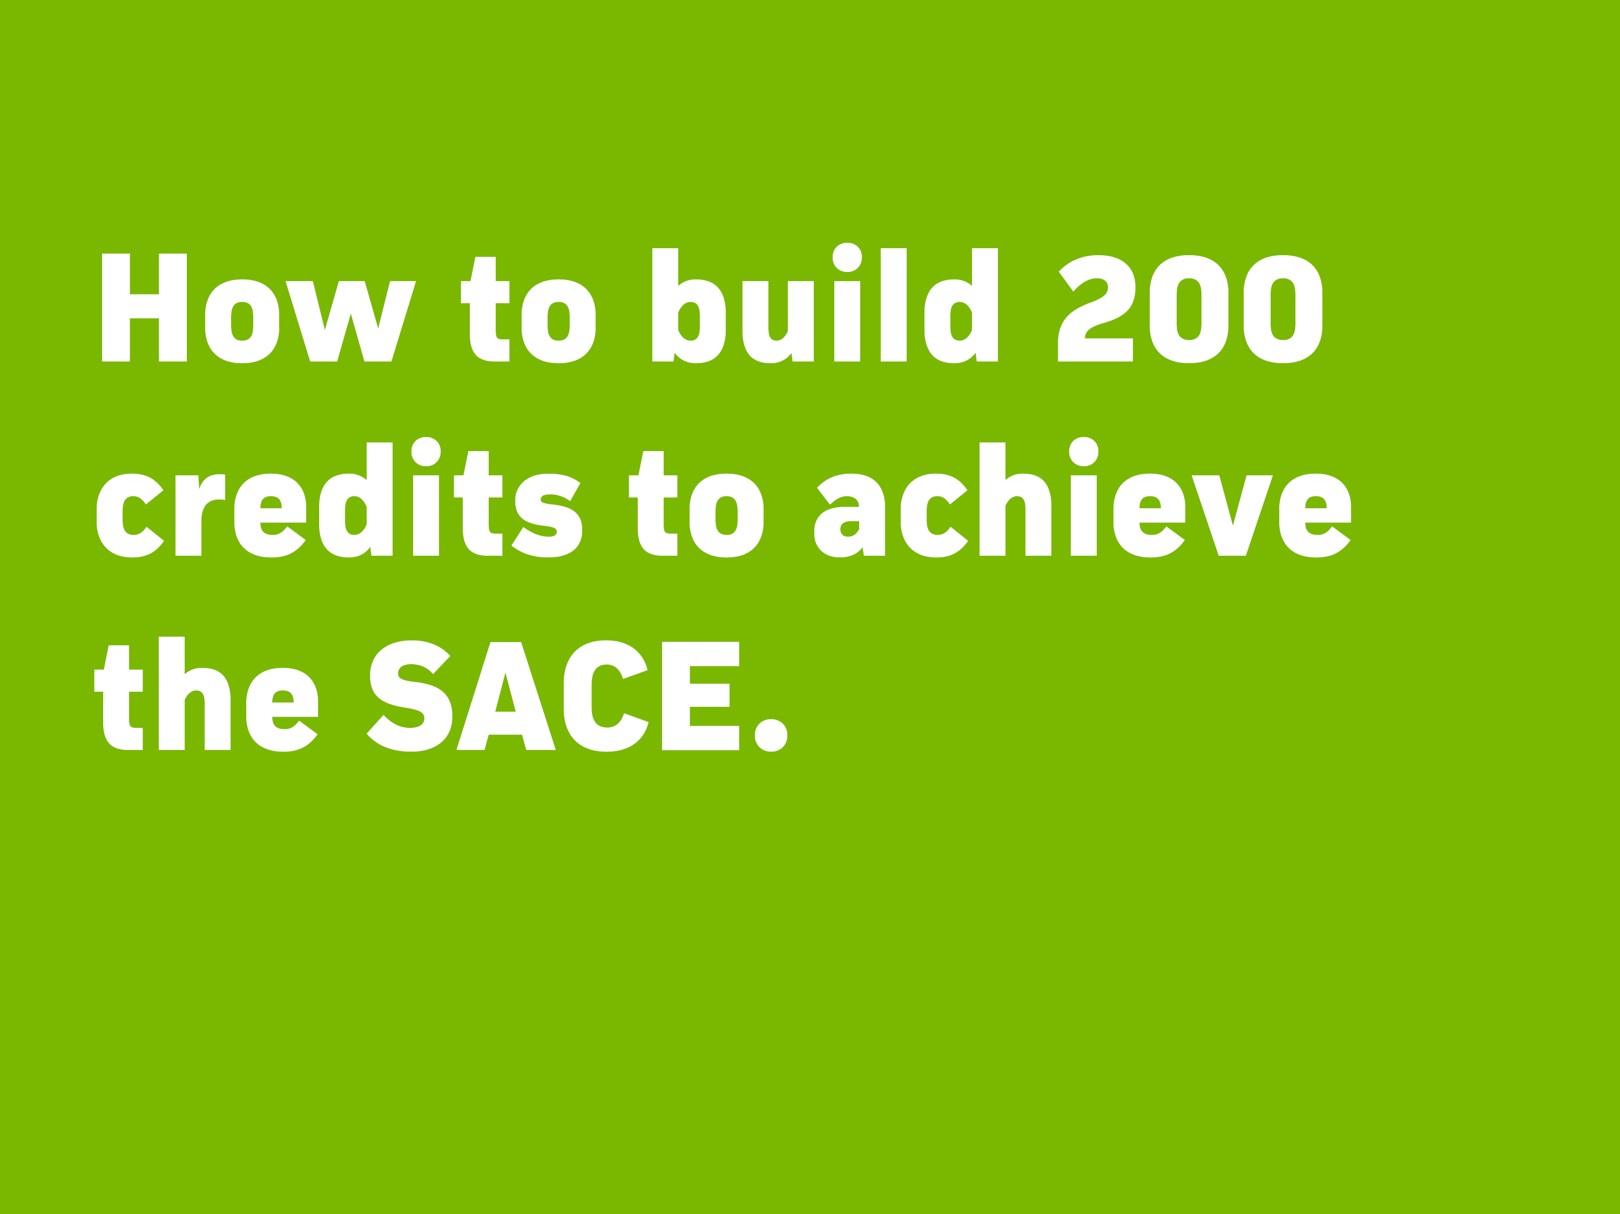
VIDEO: How to build 200 credits to achieve the SACE
Notes:
Building your credits – SACE Animation

Slide 8

WHAT IS THE PLP?
ENCOURAGES your child to think about their subject choices and future career paths
IDENTIFIES their interests and strengths and allows them to set personal and learning goals
PARTICIPATE in courses and activities outside school that will help them achieve their goals
Notes:
Your child’s SACE journey starts with the Personal Learning Plan (PLP).
What is the Personal Learning Plan (PLP)?
A 10-credit Stage 1 subject
Encourages your child to think about their choices
Identifies their interests and strengths
Sets personal and learning goals
Look at their future options and consider different career paths
Creates a solid foundation for Year 11 and Year 12 studies
Helps identify what subjects they might like to study
Participate in courses and activities outside school that will help them achieve their goals.
Your child will need to achieve at least a C grade.

Slide 9
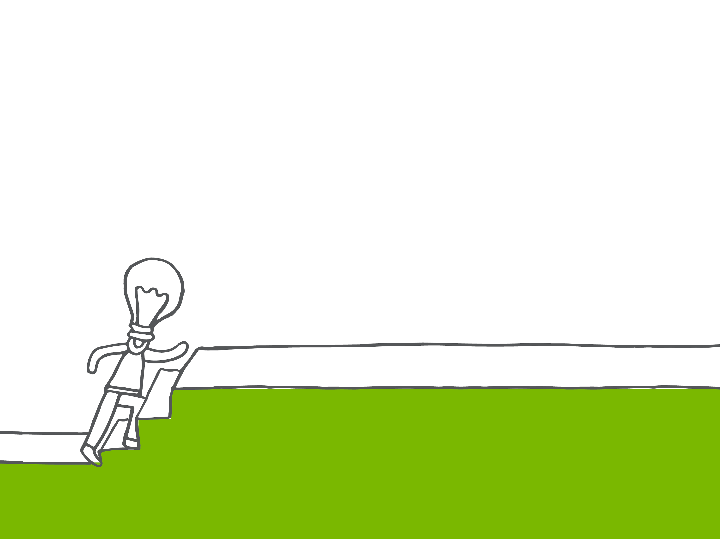
WHAT IS THE
RESEARCH PROJECT?
RESEARCH an interesting topic question in-depth.
LEARN skills needed to be successful at university,
further study, work and life.
The Research Project is a compulsory subject, worth 10 credits and requiring at least a C- grade for SACE completion.
More information at sace.sa.edu.au/research-project
Notes:
The Research Project is an important opportunity for students to develop skills relevant to their future beyond school.
The Research Project is a one semester (10 credit) compulsory subject.
Your child will research a topic question in-depth that really interests them and will explore their interest area using their creativity and initiative, and develop the research, presentation and project management skills they will need to be successful at university, further study, work and life.
Skills include the ability to analyse information, make judgement and evaluate.
Previous research questions include:
• ‘How the media influences the Australian asylum seeker debate?’
• ‘To what extent does the architectural redevelopment of the laneways in Adelaide contribute to making a more vibrant city?’
• ‘What is the best method for upholstering a chair?’
• ‘What is the future of the southern hairy-nosed wombat?’
If your child can’t think of a topic, try getting them to thinking about:
a topic that they are interested in, but haven’t had the chance to investigate
Their interests outside school
Their future plans and ambitions.

Slide 10
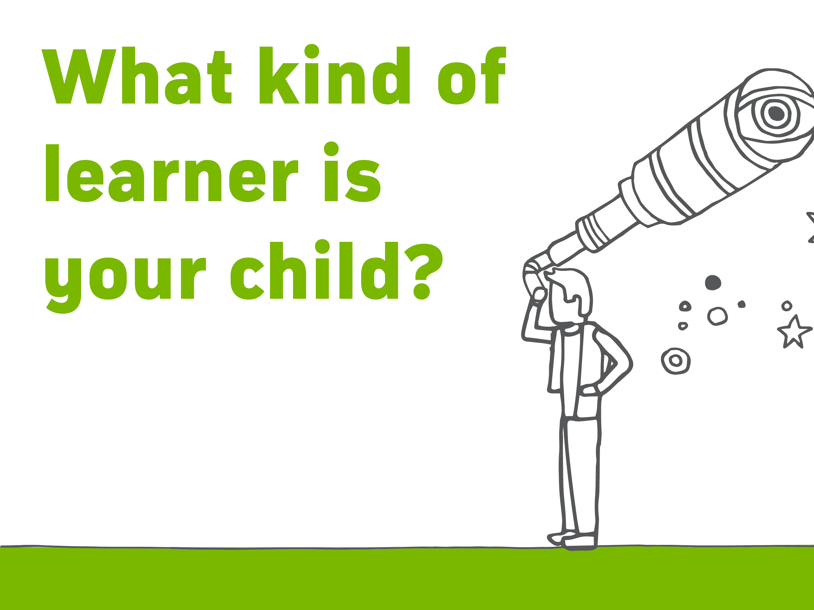
LEARN in and outside the classroom
COMBINE SACE subjects, community learning,
VET, university and TAFE studies
FLEXIBILITY to study, work part time, complete a
traineeship or apprenticeship
COMPLETE the SACE with job-ready skills
Notes:
The SACE is flexible, and caters for learning both in and outside school.
Students can combine study and part time work, a traineeship or school-based apprenticeship.
Students can receive credits for a wide range of activities and training:
SACE subjects
Vocation education and training (VET)
Community learning
University and TAFE studies
VET options are available at both Stage 1 and Stage 2 and include a wide range of industry areas, including construction, automotive, electro technology, hospitality, community services, health and information technology.
You can find a range of Stage 1 and 2 subjects offered, vocational education and training (VET) courses plus other options on the SACE website.

Slide 11
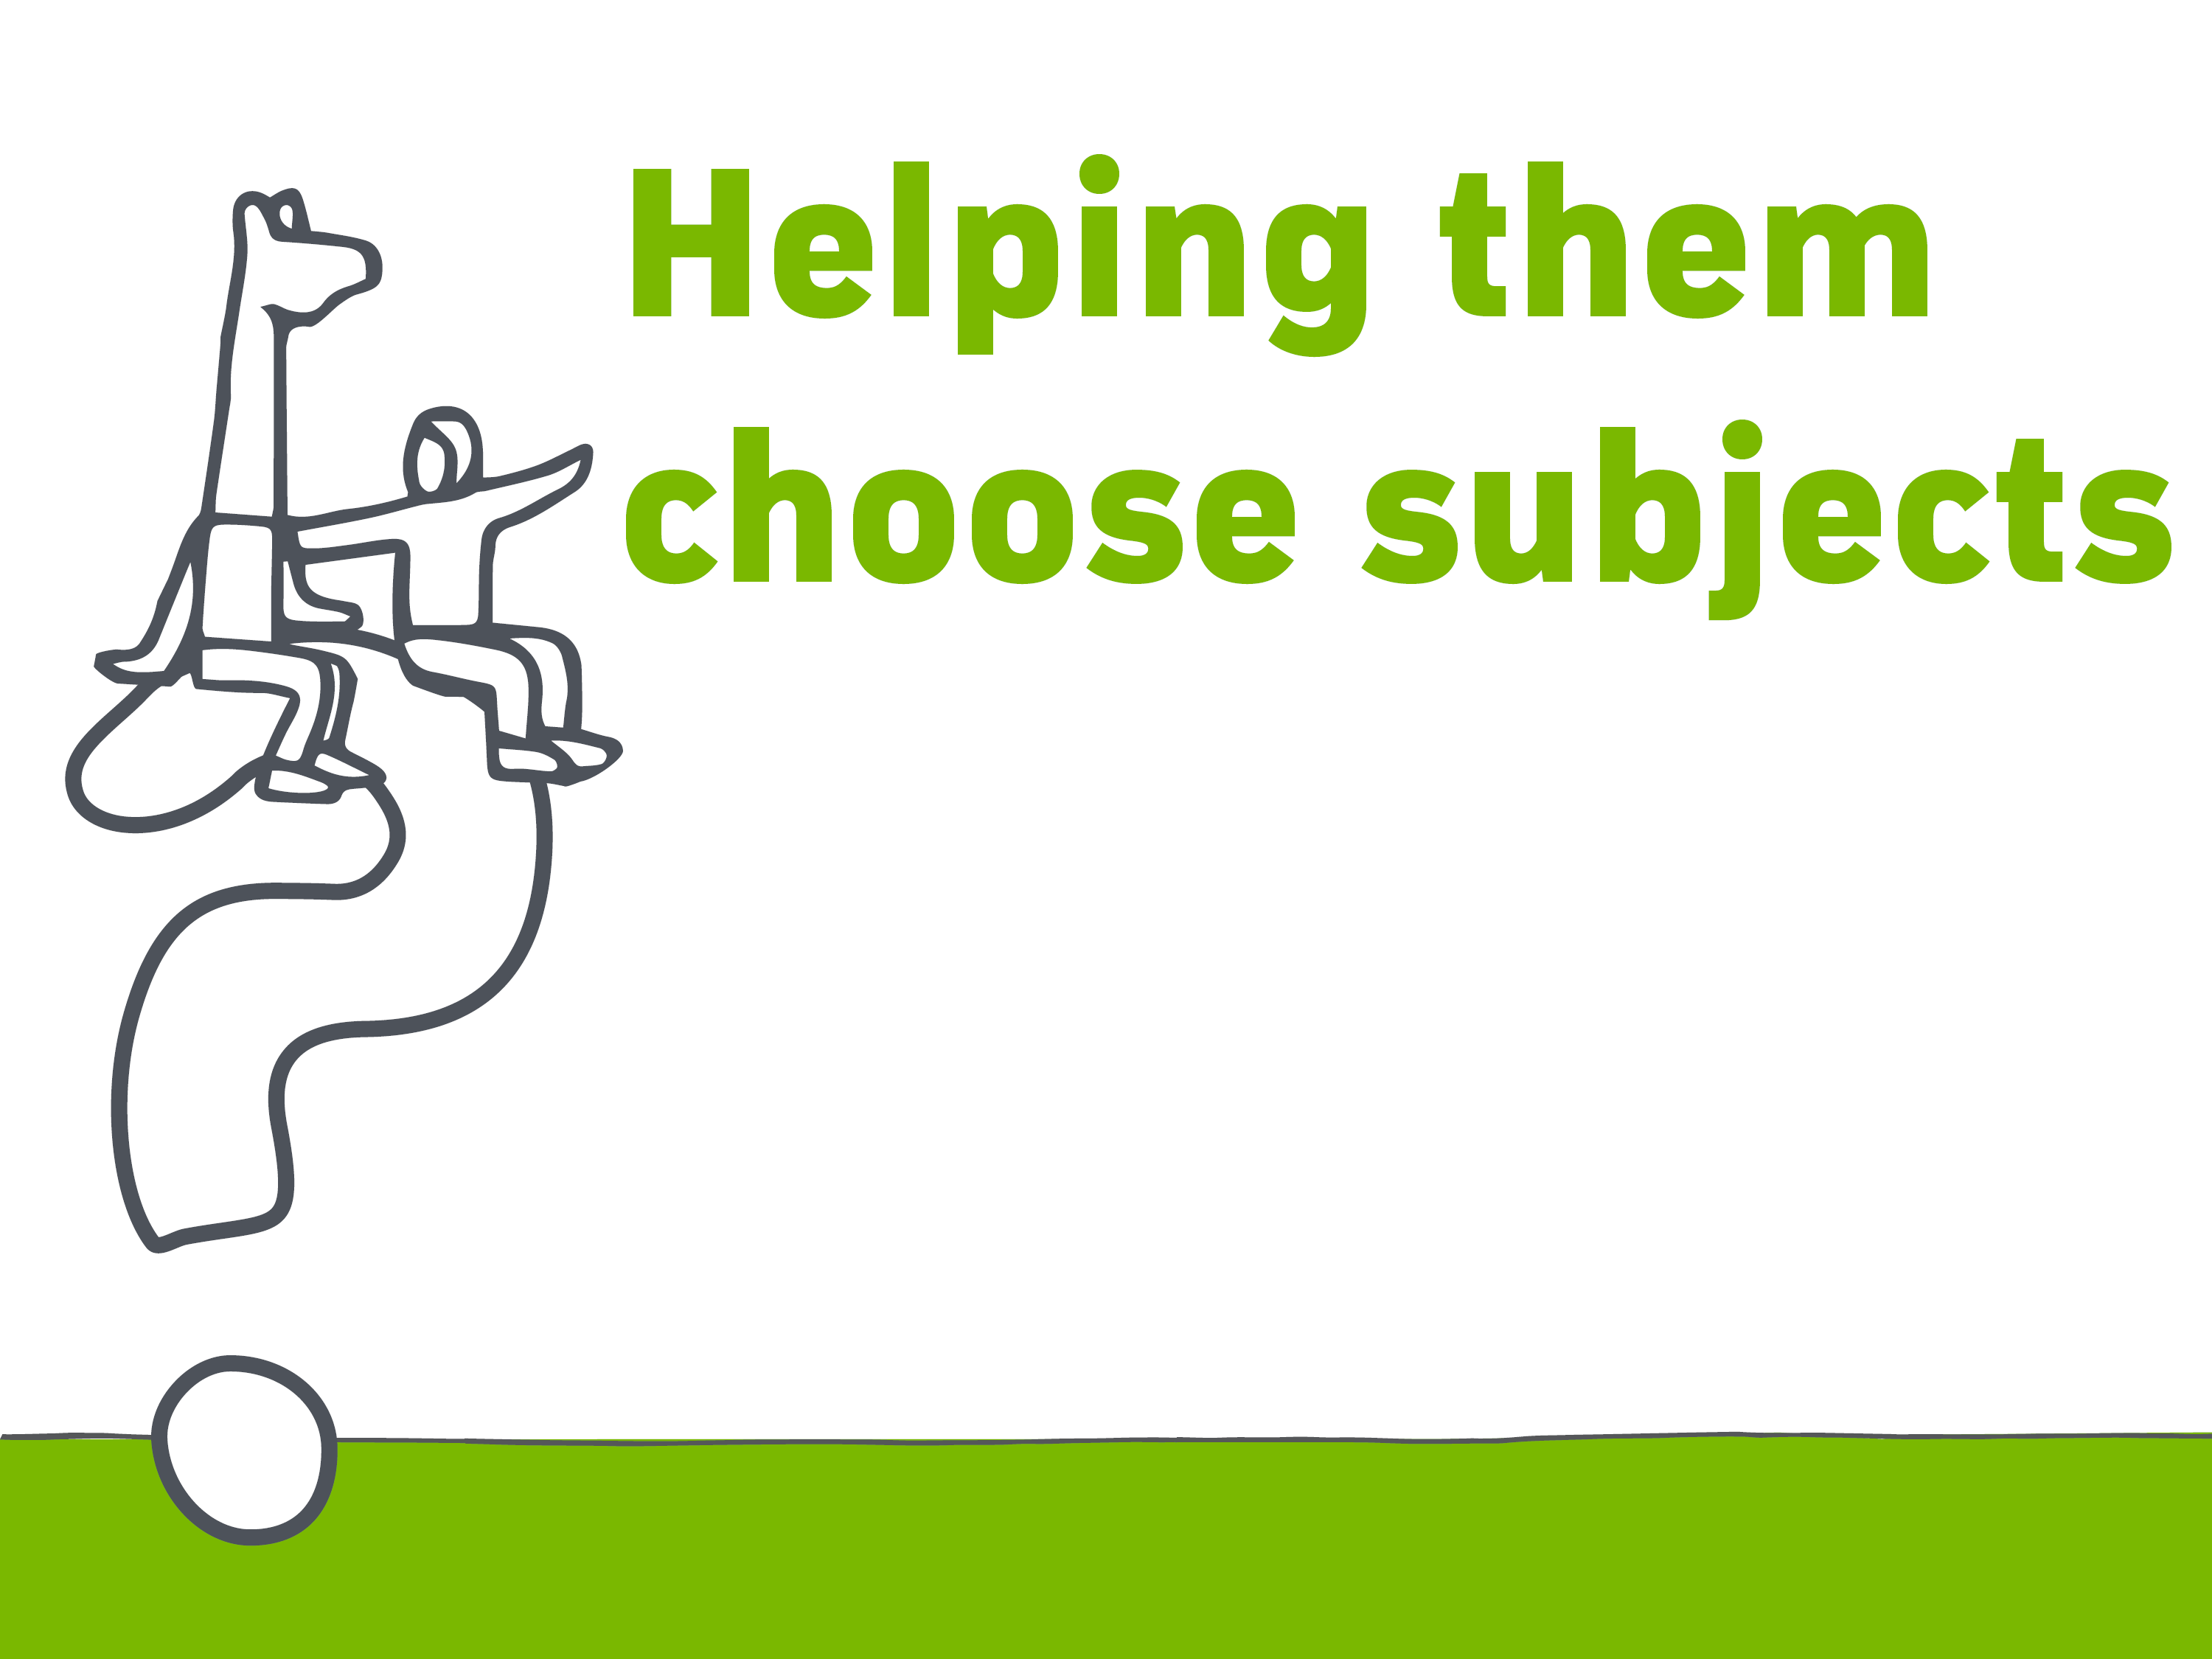
WHAT…
am I interested in and good at?
sort of job, or types of work, will help me follow my interests?
subjects do I need to study to follow my chosen career pathway?
do I hope to gain from my studies?
have I learned during my PLP course?
Find out more at sace.sa.edu.au/studying/subjects
Notes:
Questions for your child to ask themselves:
What am I interested in?
What am I good at?
What sort of job, or types of work, will help me follow my interests?
What subjects do I need to study to follow my chosen career pathway?
What I hope to gain from my studies?
What have I learned during my PLP course?
TIP – encourage them to try and choose subjects that will open doors to a range of careers within their area of interest
This will give them greater flexibility if they want to change or modify their choice in the future.
You can find out more about credits and choosing subjects, VET courses and recognised learning on the SACE website.

Slide 12
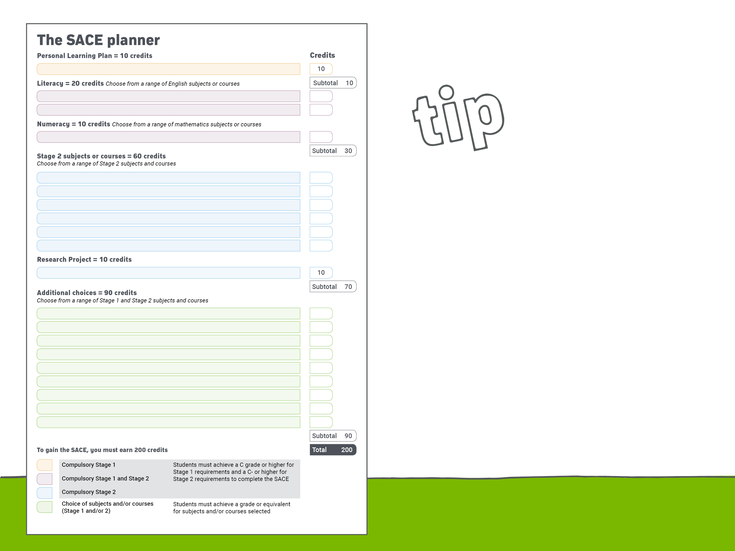
WHEN choosing Stage 2 subjects,
your child should keep in mind
any subjects that are required
for the university courses they
may be interested in.
TIP
Notes:
The SACE Planner outlines the requirements and can help your child with their subject selection.
TIP: When choosing Stage 2 subjects, your child should keep in mind any subjects that are required for the university courses they are interested in.

Slide 13
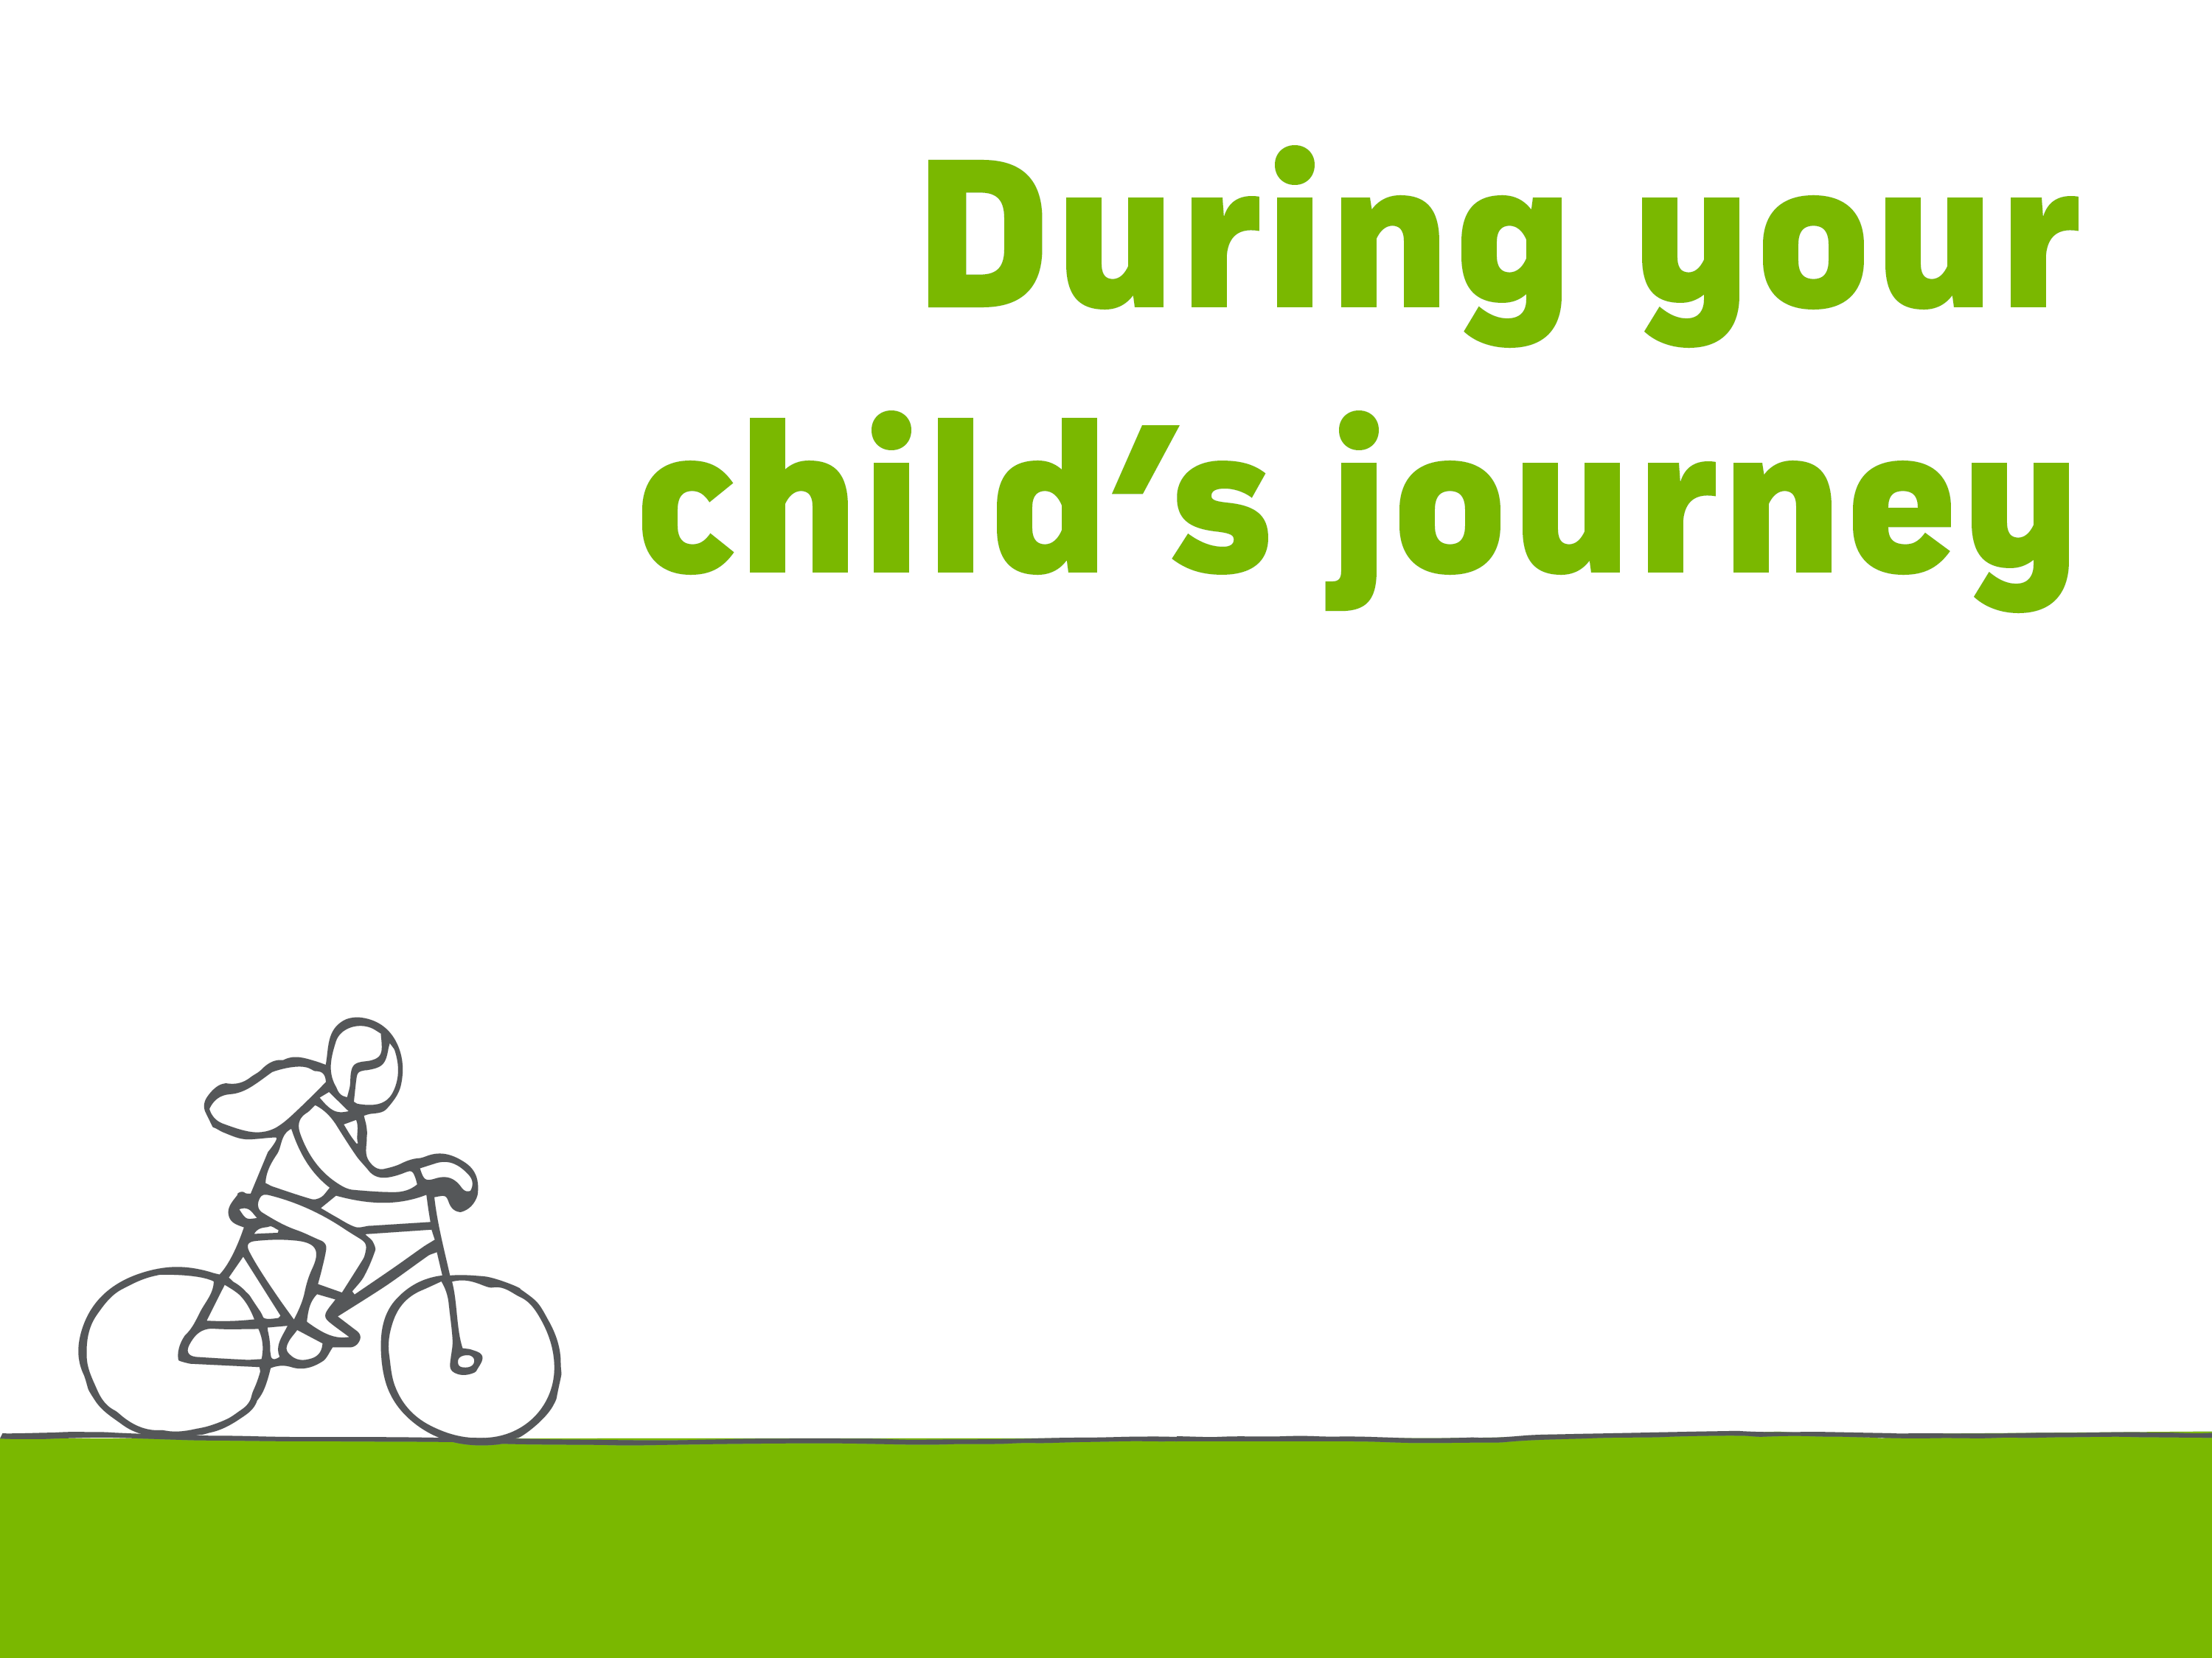
THE SACE Board supports students by working with schools
to provide reasonable adjustments where appropriate.
SPECIAL provisions support eligible students
to ensure they have the opportunity to positively
demonstrate their skills and understanding of the subject.
MODIFIED subjects are available for students
with significant impairment in intellectual functioning and/or adaptive behaviours associated with their disability.
Notes:
Sometimes a student’s journey is complicated by disability, misadventure or personal circumstances.
Special provisions
Special provisions are a range of adjustments that are made to allow eligible students to access learning and assessment on the same basis as other students. These might be adjustments such as extra time for tests, extended deadlines or using adaptive technology.
Special provisions are available in stages 1 and 2 and for both the school assessed and externally assessed components. Special provisions may administered for a short term or on a long term basis according to the needs of the student. Each case is individual.
Modified Subjects
Access to modified subjects is intended for the small number of students with significant impairment in intellectual functioning and/or adaptive behaviours associated with their disability, whose learning needs cannot be met through differentiation or special provisions.
This group of eligible students has access to modified subjects which focus on personalised learning goals and the development of the capabilities.
Subjects are assessed as ‘Completed” or ‘Not Completed”.
Eligible students may also access the full range of flexible subjects and VET to complete their SACE.
www.sace.sa.ed.u.au/web/modifed-subjects

Slide 14

PERFORMANCE STANDARDS
are used by teachers to decide
how well a student has
demonstrated their learning.
These standards assist in determining student GRADES.
STAGE 1 is school assessed Grading: A to E
STAGE 2 is a shared
responsibility between our
school and the SACE Board.
Grading: A+ to E–
Notes:
Student work in the SACE is assessed through the use of performance standards. SACE subjects are assessed by the school at Stage 1. The responsibility for assessment at Stage 2 is shared between schools and the SACE Board.
Teachers and assessors use the performance standards to decide how well a student has demonstrated his or her learning.
The performance standards, which are provided in each subject outline, describe in detail the level of achievement required to obtain a grade:
from A to E for Stage 1
from A+ to E– for Stage 2.
SACE quality assurance processes are in place to ensure that grades across the state are consistent.
Moderation – student work is marked by the teacher and samples are sent to the SACE Board for moderation.
Marking – 30% of Stage 2 subjects are externally assessed, which means they will be marked by someone other than your child’s teacher, and overseen by the SACE Board.

Slide 15

RESULTS
Your child will receive their final results in Students Online on the SACE website. sace.sa.edu.au
SATAC
Provides students with their ATAR satac.edu.au
Notes:
At the end of Stage 2, your child will receive their final results for all SACE subjects they have completed. These grades are available in Students Online on the SACE website.
On the same day the South Australian Tertiary Admissions Centre (SATAC) will release the ATAR and your child will be able to find out if they are eligible for:
an Australian Tertiary Entrance Rank (ATAR) which they can use to apply for university

Slide 16

AUSTRALIAN Tertiary Admissions
Rank issued by SATAC and used
by universities to select students
for courses
MEASURES a student’s overall
achievement compared
with all students nationally
RANGES from 0 to 99.95.
The score is calculated from your
child’s 90 credit, Stage 2 results
Notes:
What is an ATAR?
An Australian Tertiary Admissions Rank is used by universities to select students for courses.
It measures a student’s overall achievement compared with all students nationally and ranges from 0 to 99.95
The score is calculated from your child’s 90 credit, Stage 2 results.

Slide 17
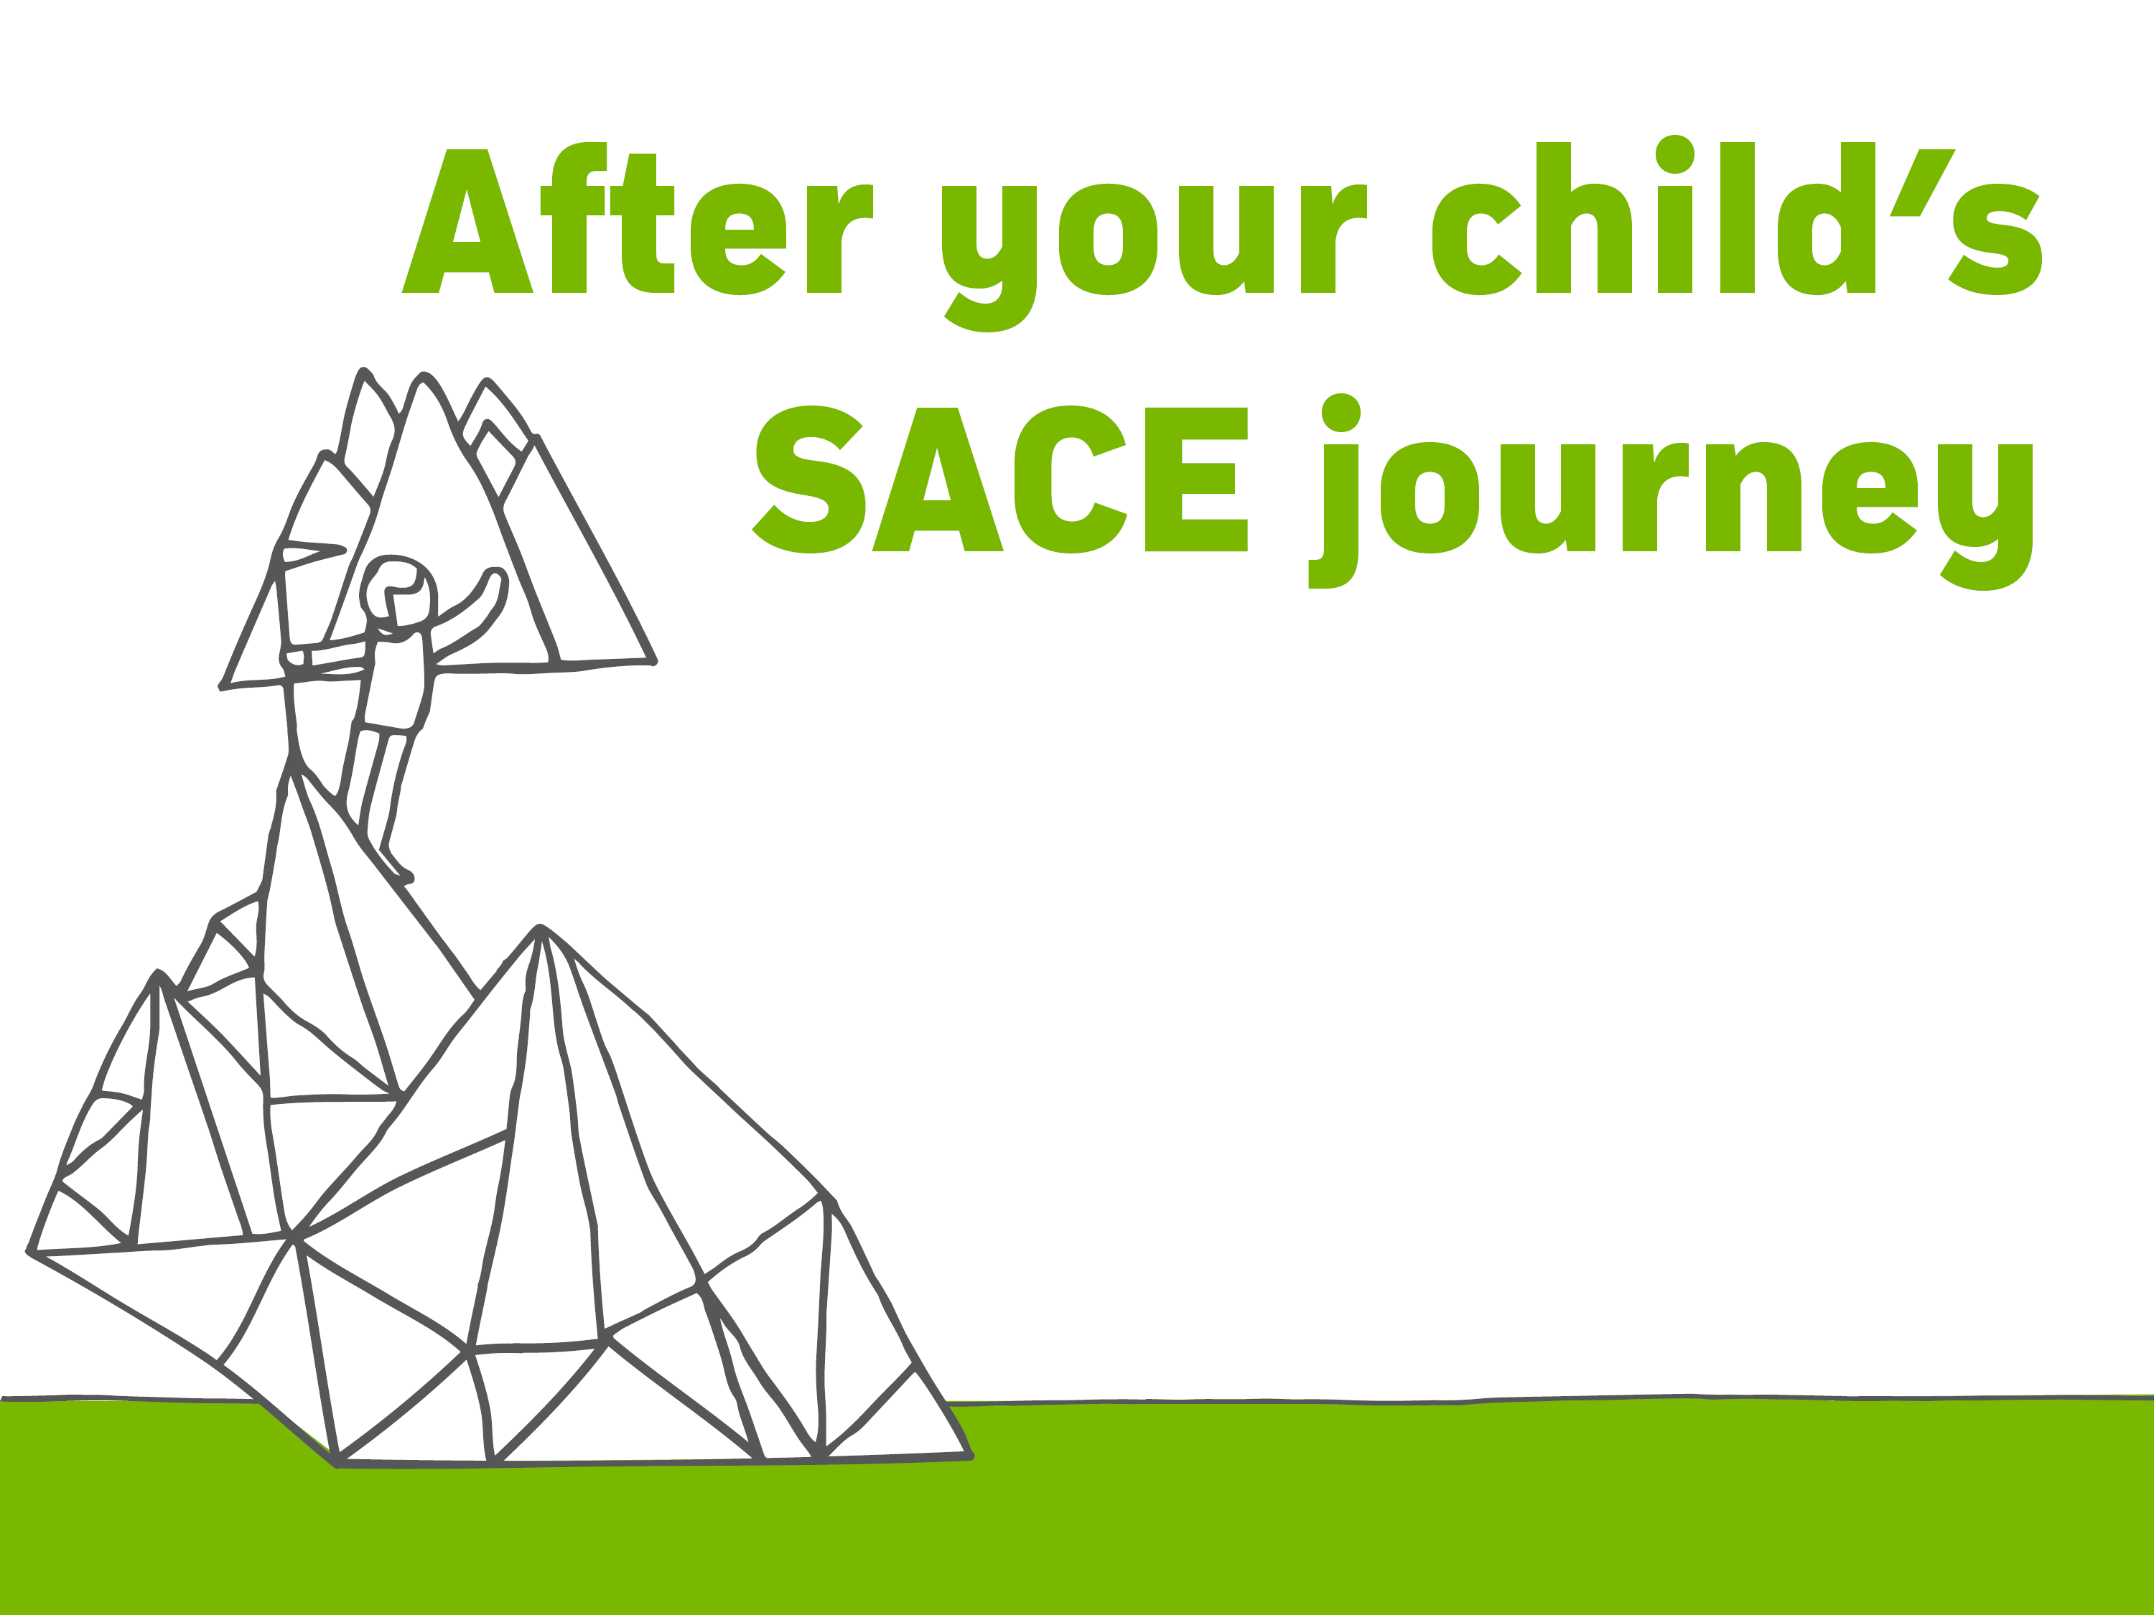
UNIVERSITY
COMPLETED the SACE with at least 90 credits at Stage 2
GAINED a university aggregate and an ATAR
MET any university prerequisite requirements and rules
APPLIED through the South Australian
Tertiary Admissions Centre (SATAC).
Notes:
Achieving the SACE is important if your child wants to study at TAFE or university, but there are also other pathways after secondary school. The SACE also offers the flexibility to move smoothly from high school to employment.
University pathways
Successful completion of the SACE is the most common way for students to gain entry to local and international universities.
To be eligible to apply for university, South Australian students must have:
completed the SACE with at least 90 credits at Stage 2
gained a university aggregate and an ATAR
met any prerequisite subject requirements for their chosen university course
complied with rules regarding subject combinations and counting restrictions
Application for entry to university courses is made through the South Australian Tertiary Admissions Centre (SATAC). More information is available in the SATAC booklet and on the SATAC website www.satac.edu.au.

Slide 18
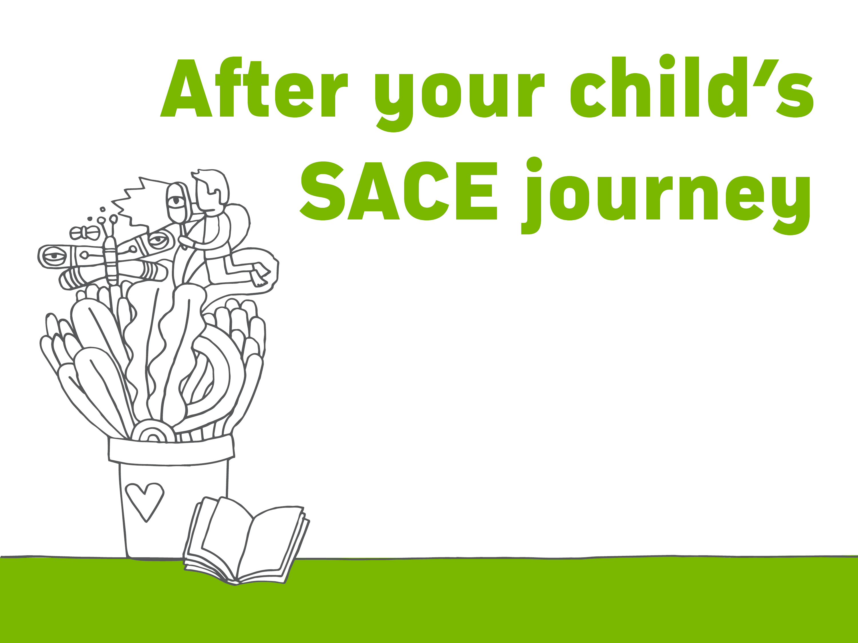
TAFE
ENTRY requirements and a list of all the courses
offered by TAFE can be found at tafesa.edu.au
PREPARES your child for employment in professional,
para-professional, technical and trade careers
Notes:
TAFE pathways
TAFE SA campuses offer courses to prepare your child for employment in professional, para-professional, technical and trade careers.
Entry requirements may vary depending on the level of the qualification.
Details of these requirements and a list of all the courses offered by TAFE can be found on the TAFE website.

Slide 19
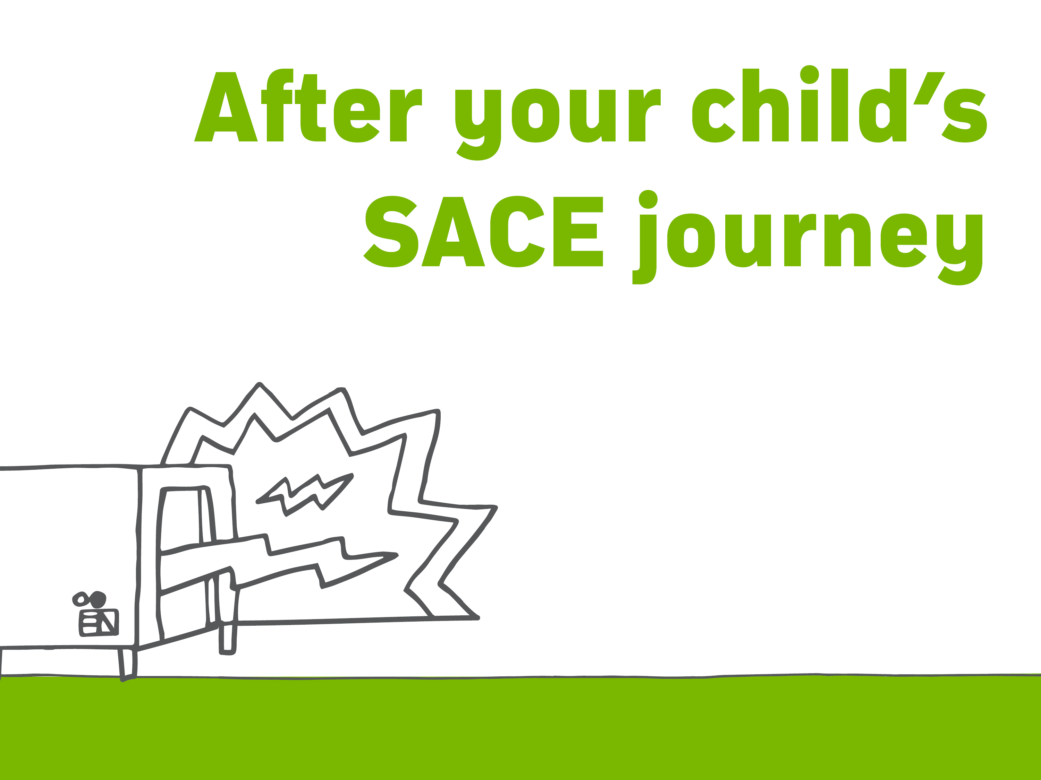
EMPLOYMENT AND TRAINING
TRAIN in a recognised VET course
or school-based apprenticeship
while completing the SACE
GET a head start on their career
CHOOSE from a wide range of industry areas
Find a list of VET courses at sace.sa.edu.au
Notes:
Employment and training
The SACE offers the flexibility to move smoothly from high school to employment.
VET courses can count towards their SACE at both Stage 1 and Stage 2. This means they can be working towards, or may even have gained, a VET qualification by the time they finish the SACE – giving them a head start on their career and employment.
After completing their SACE your child can continue with their chosen pathway or start a new one, choosing from a wide range of industry areas, including construction, automotive, electro technology, hospitality, community services, health and information technology.
More information is available at www.skills.sa.gov.au/careers-jobs

Slide 20

OUR SCHOOL is here to provide
information to you and your child
MY DETAILS
Toby Watts
PHONE: 8394 5400
EMAIL:
Toby.watts@uhs.sa.edu.au
HELP your child select subjects that
suit their interests and future plans
ADVISE them on the best subjects and VET
courses to take for their preferred tertiary
education course or area of employment
Notes:
Our school
Our school’s SACE coordinator, teachers and other school leaders are here to help and can:
Offer advice and information on the subjects being offered
Help your child select subjects that suit their interests and plans
Advise your child about the best subjects to take to prepare for their preferred tertiary education course or area of employment
Advise your child on vocational education and training (VET) options available to them, through our school or a registered training organisation (RTO).

Slide 21

?
Notes:
If you are looking for ways to further support your child through their SACE journey, more information can be found under ‘studying the SACE’ on the SACE website www.sace.sa.edu.au
Alternatively contact the SACE Board at:
60 Greenhill Road, Wayville
South Australia, 5034
8115 4700
SACE.Info@sa.gov.au

Slide 22


Slide 23


